Slide 1


SEC5-GRP14
Brazilian E-commerce Data Analytics by Olist
NAME | CRANES REG. NO. | REG. NO.
CHANDAN CHOUDHURY | CL2025010601911046 | 2201020352
ADITYA NAYAK | CL2025010601911349 | 2201020377
BISWOJIT LENKA | CL20250106018928110 | 2201020371
ADITYA SINHA | CL20250106018930112 | 2201020378
CH. JAGAN SUBUDHI | CL20250106018923105 | 2201020364
JAIJEET PAUL | CL2025010601897533 | 2201020357
AMAN VERMA | CL2025010601911147 | 2201020359
Guided by Partha Chatterjee Sir

Slide 2
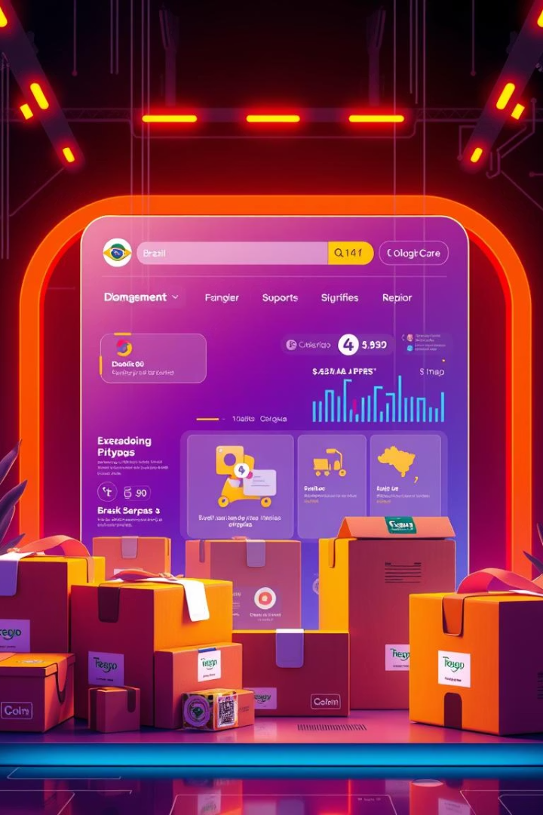
Introduction to the Project
Dataset Overview
The project analyzes Brazil’s largest public e-commerce dataset from Olist, featuring transactional, logistical, and customer review data from 2016 to 2018. This includes orders, payments, products, and geographical details.
Objectives
To explore and visualize order trends and seasonality in Brazilian e-commerce.
To evaluate delivery performance and identify delays.
To analyze customer behavior, preferences, and satisfaction through reviews.
To understand payment patterns and popular payment methods.
To draw data-driven business insights that can be used to enhance customer service and logistics planning.

Slide 3
Dataset Description and Structure
Comprehensive Dataset
Volume and Time Span
The dataset consists of 9 linked CSV files capturing customer, order, product, payment, review, seller, and geolocation information.
Over 100,000 records covering multiple customer journeys and business interactions from 2016 through 2018, enabling rich temporal and behavioral analysis.
customers.csv - IDs and locations
orders.csv & order_items.csv - timelines and statuses
order_payments.csv - method and installments
order_reviews.csv -customer feedback and scoring
products.csv – Product category, name, and dimensions
sellers.csv – Information about sellers and their locations
product_category_name_translation.csv – English translation of Portuguese category names
geolocation.csv – Latitude and longitude data for zip codes

Slide 4

Tools and Technologies Used
Programming
Python Libraries
Python was the main language, facilitating data manipulation, analysis, and building interactive dashboards.
Machine Learning:
XGBoost for regression tasks.
Scikit-learn for model training and evaluation.
TensorFlow for building the LSTM model.
Pandas for data wrangling
Matplotlib and Seaborn for static plots
Plotly for interactive visualizations
Streamlit for dashboard creation
Development Environment
Exploratory work was conducted in Jupyter Notebook to allow flexible iteration and inline visualization.

Slide 5
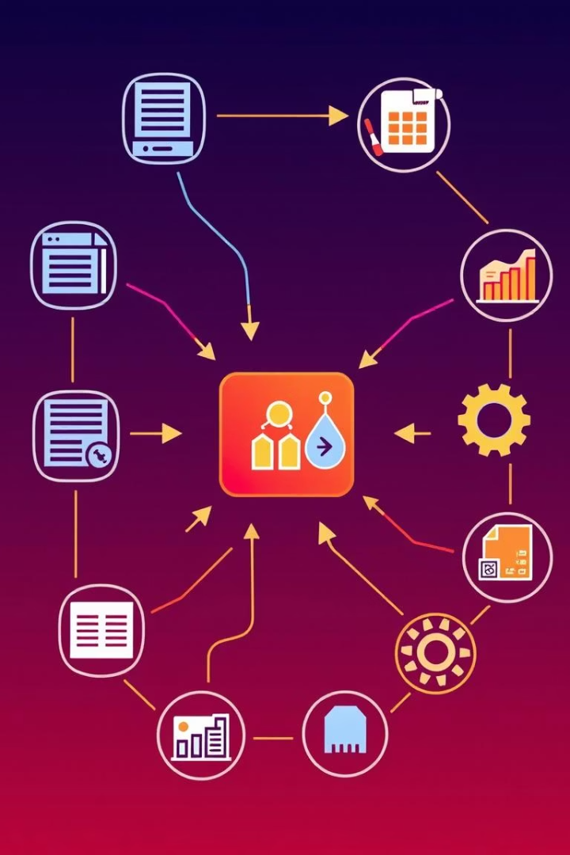




Data Preprocessing Steps
Handling Missing Values
Addressed incomplete fields through removal or imputation to maintain dataset integrity for analysis.
Dataset Merging
Linked multiple tables via order_id, customer_id, and product_id to create a cohesive master dataset.
Duplicates and Anomalies
Removed redundant or inconsistent data entries and corrected errors in product categories and location names.
Date Conversions
Converted date columns to datetime objects enabling time-series analysis and trend identification.

Slide 6




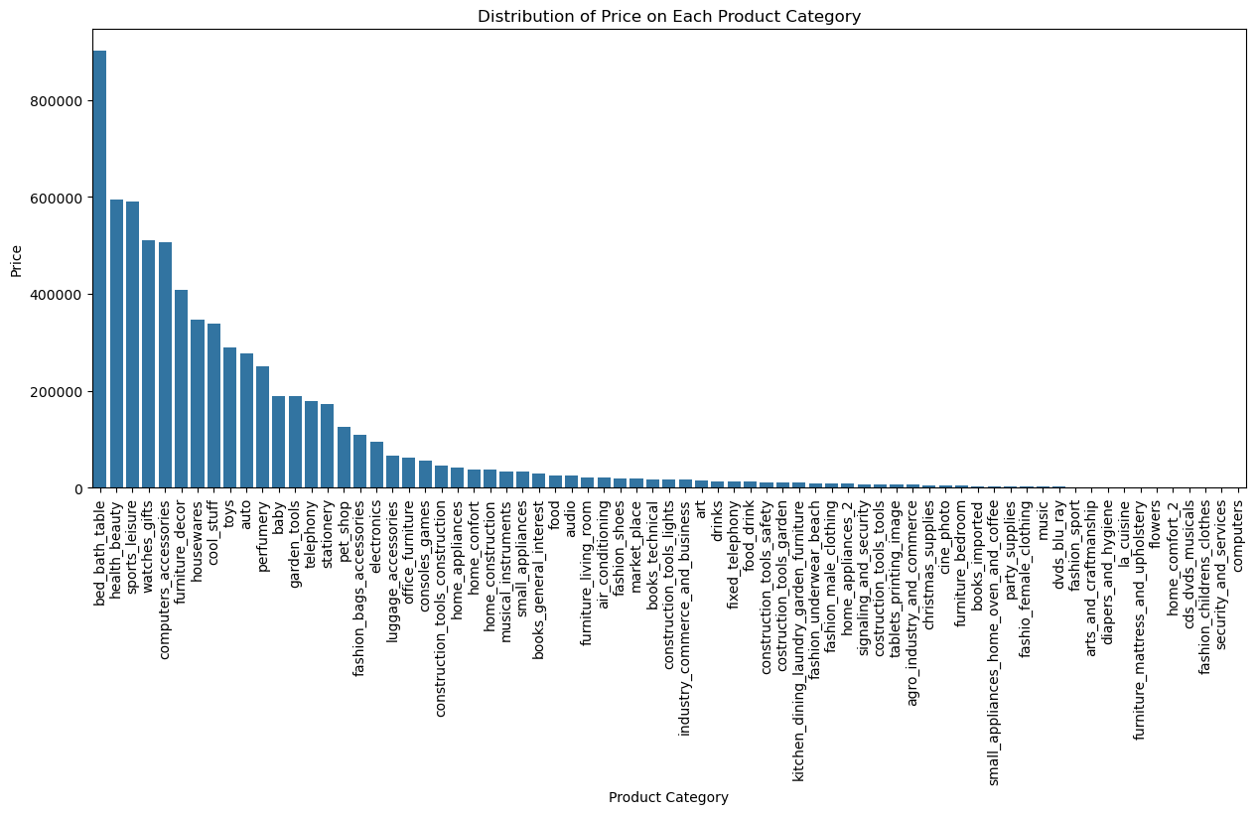
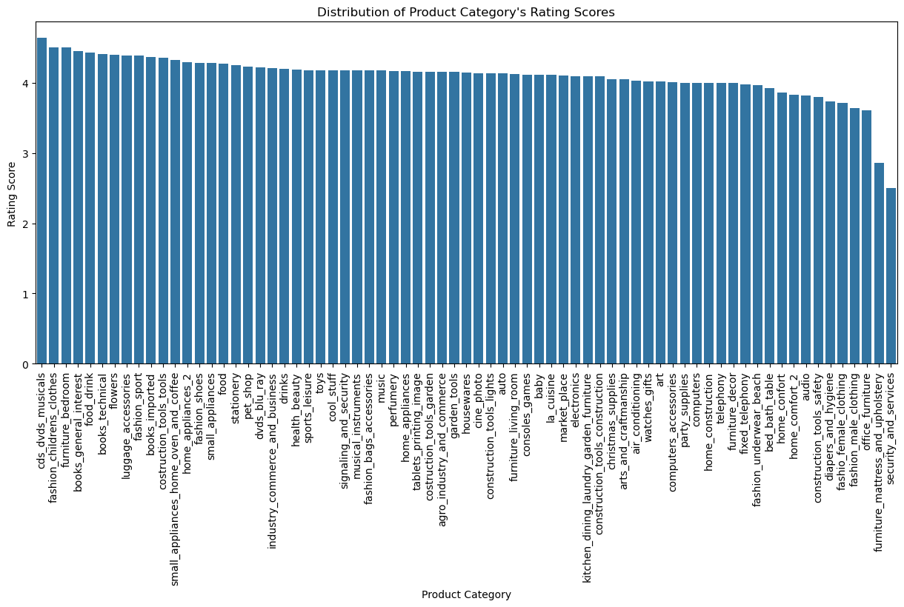
Exploratory Data Analysis (EDA)
Sales Trends
Top Categories
Customer Behavior
Review Distribution
Analyzed sales fluctuations over time identifying seasonal patterns and peak shopping periods.
Identified highest selling product categories driving revenue growth in the marketplace.
Explored order frequency, repeat purchases, and preferences through purchasing patterns.
Examined customer ratings to gauge overall satisfaction and product feedback trends.

Slide 7



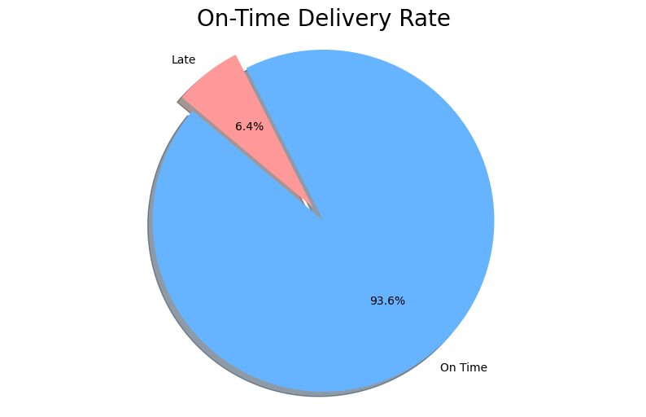


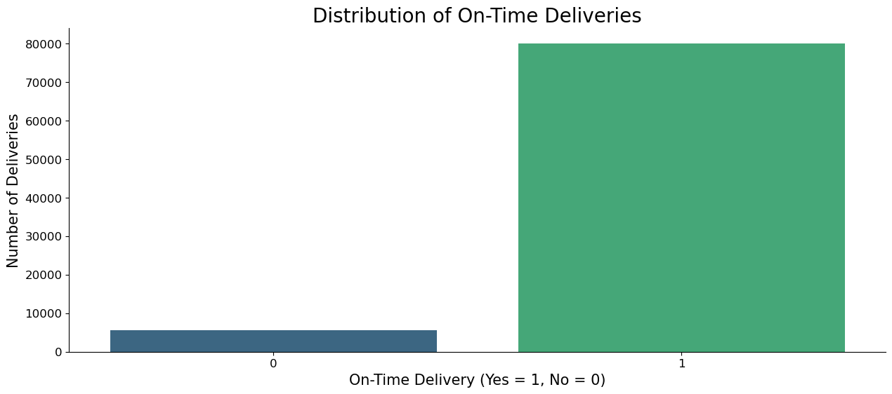

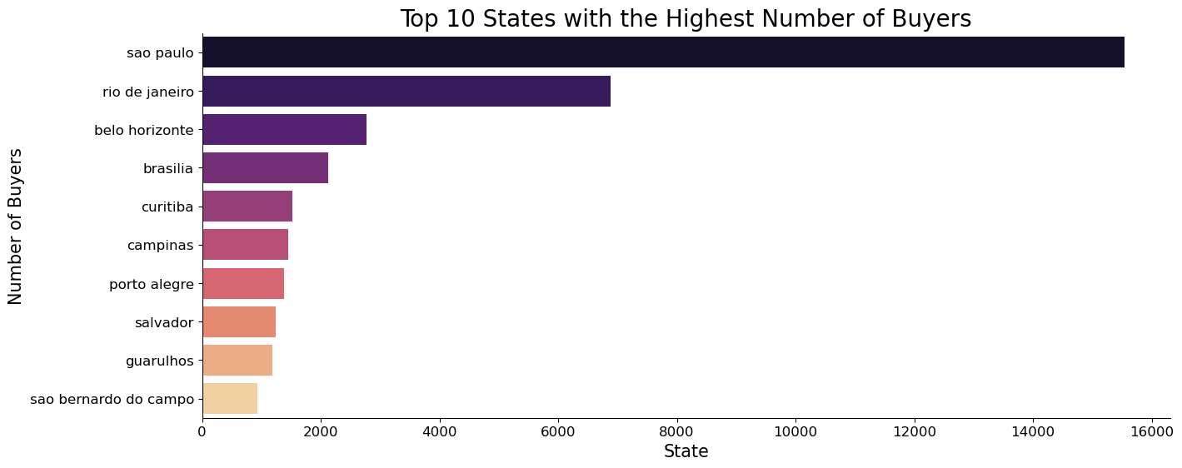
Delivery Performance Analysis
Ontime & Late Deliveries
Calculated percentage of orders delivered past estimated dates to identify bottlenecks. On-Time Delivery Rate: 93.57%
On-time Delivery Distribution
Displayed the count of orders delivered on time vs delayed, providing insights into the overall punctuality of the e-commerce logistics system.
Regional Patterns in Sales
Analyzed Sales Region Wise .

Slide 8

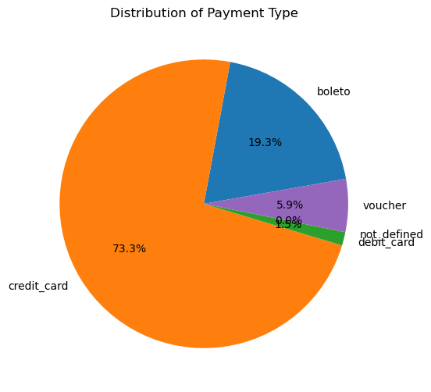
Payment Method Analysis
Payment Type
Usage Percentage
Credit Card
73.3%
Boleto
19.3%
Voucher
5.9%
Credit cards dominate the payment landscape, followed by boleto slips commonly used in Brazil. Installment purchasing is prevalent, reflecting local consumer preferences. Revenue breakdown shows strong reliance on credit transactions for high-value sales.

Slide 9
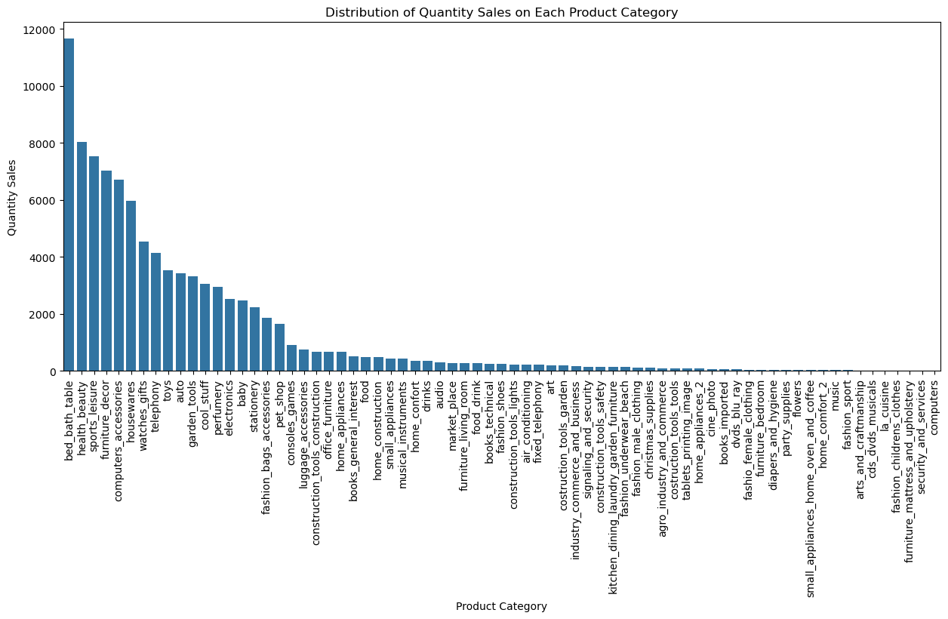
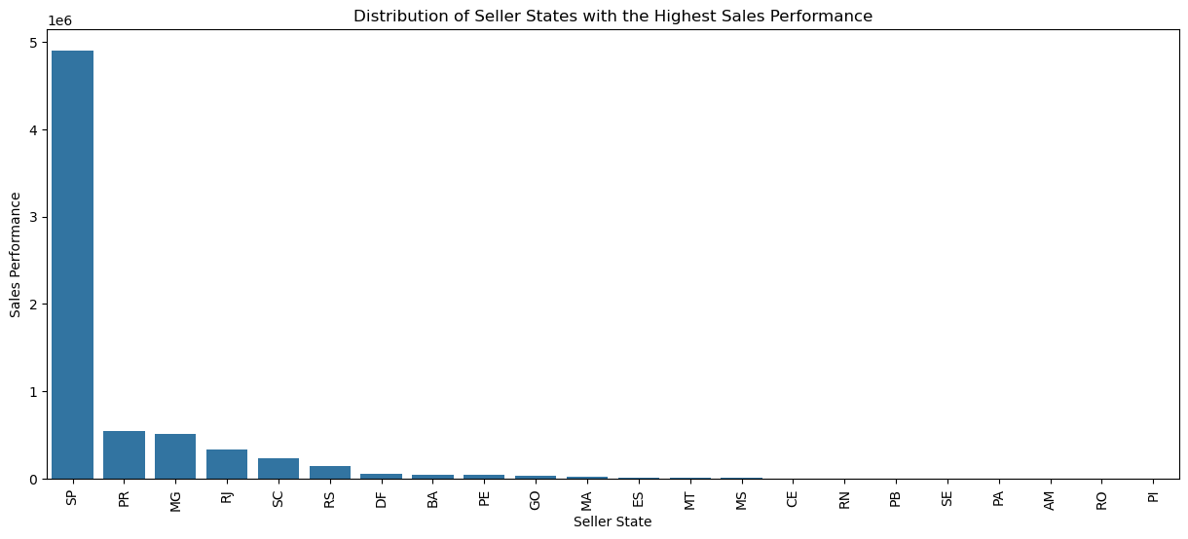
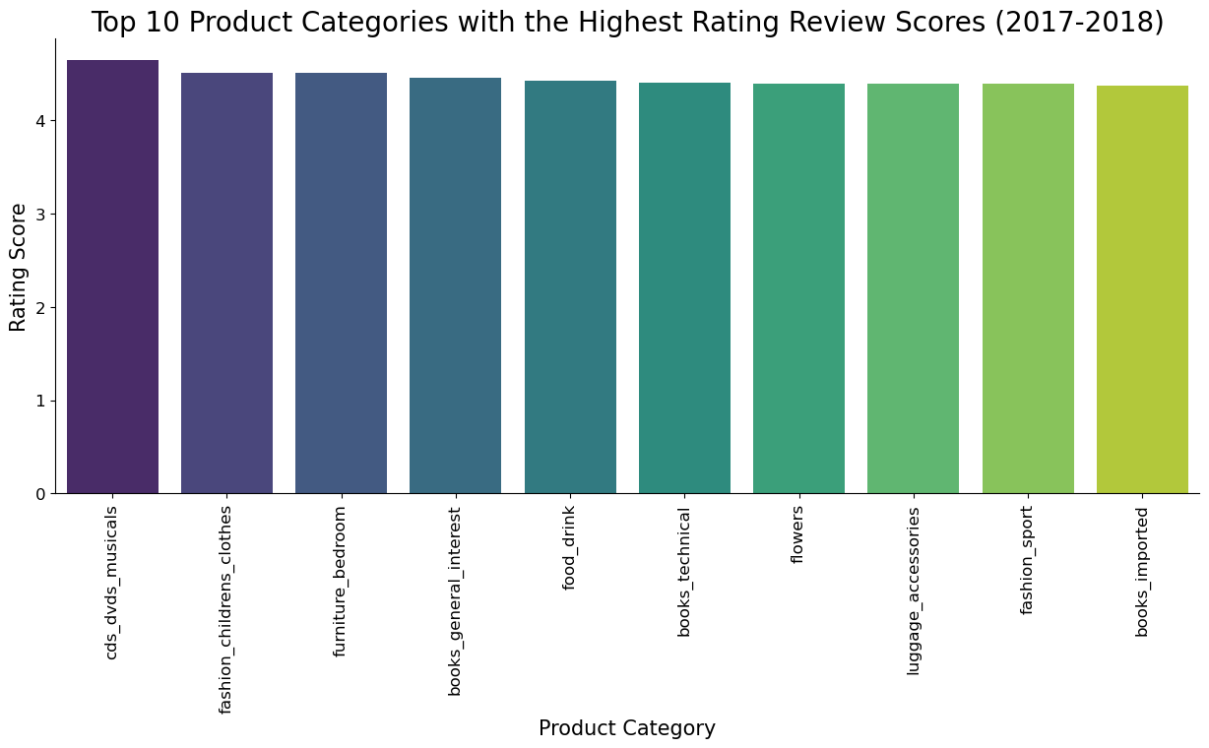
Key Business Insights
Top Categories
Regional Sales
Customer Satisfaction
Home appliances lead sales, showing sustained consumer demand.
São Paulo and Rio de Janeiro stand out as highest sales states, driven by population and infrastructure.
Positive review patterns correlate with faster delivery and better product quality, crucial for retention.

Slide 10
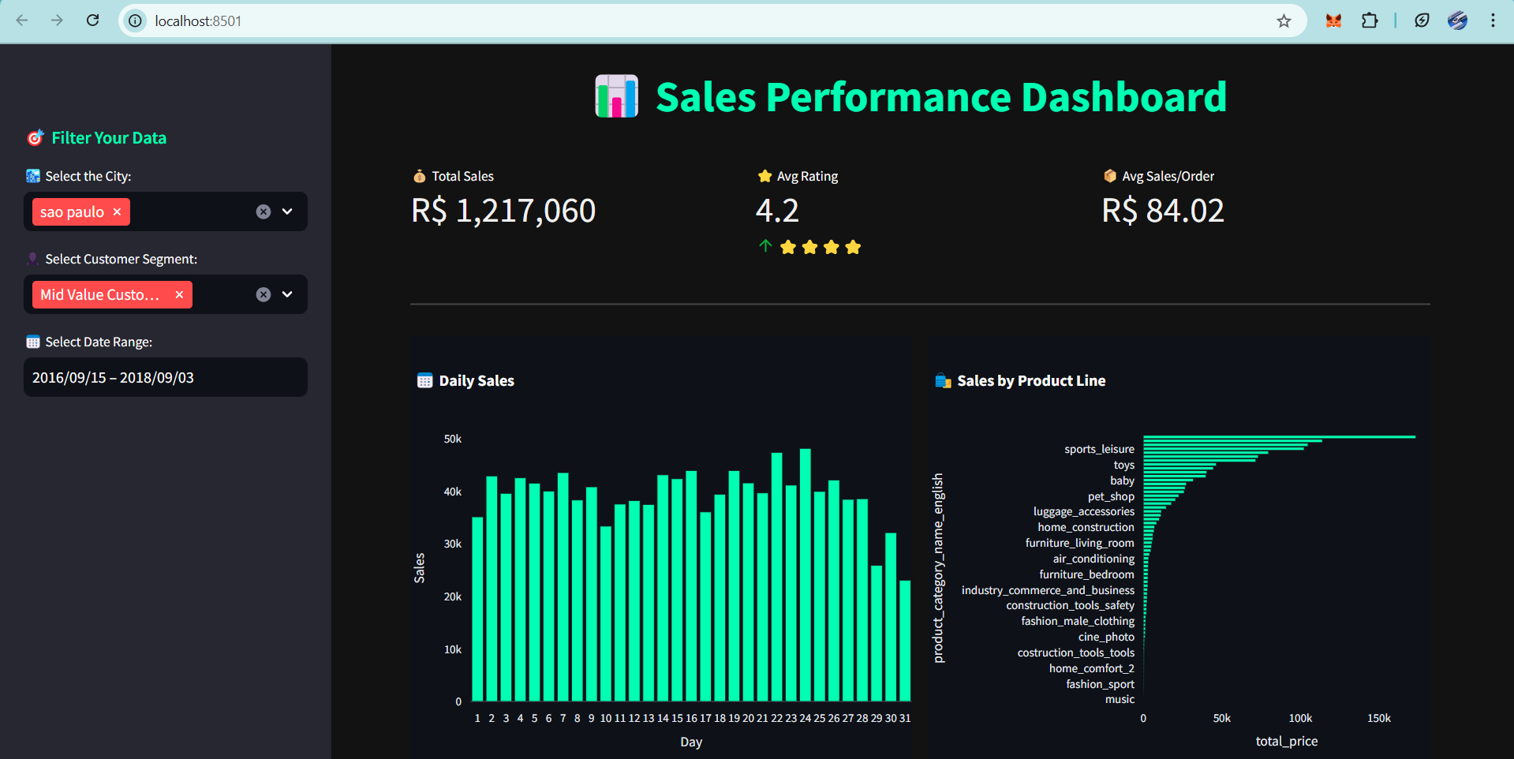
Streamlit Dashboard

Slide 11
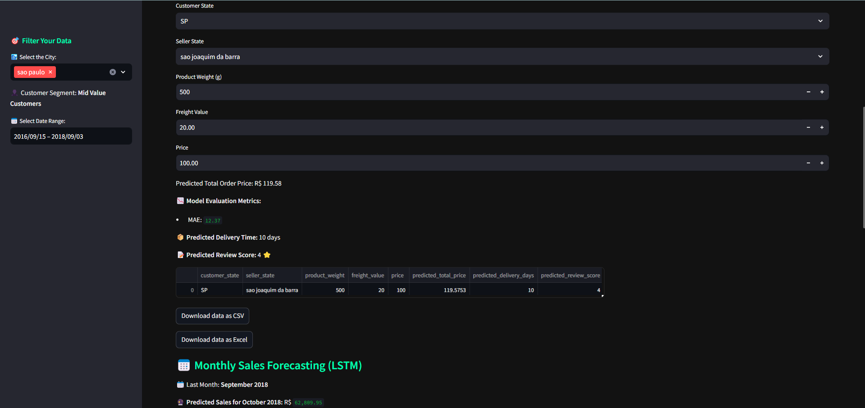
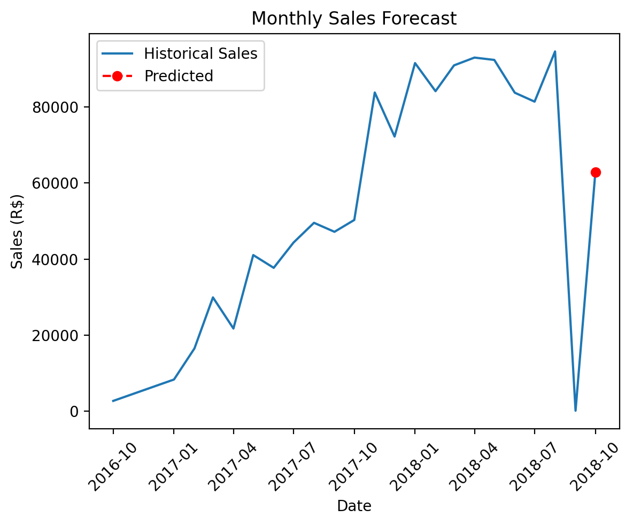
Streamlit Dashboard
Features
Interactive Filters: Filter data by city, customer segment, and date range through an intuitive sidebar.
Key Performance Indicators (KPIs): Display total sales, average rating, and average sales per order.
Visualizations:
Sales by Product Line: Horizontal bar chart showcasing sales distribution across product categories.
Daily Sales: Bar chart illustrating sales trends over days.
Predictive Analytics:
Predict total order price based on input features like freight value and price.
Estimate delivery time using a Random Forest Regressor.
Classify review scores using a Random Forest Classifier.
Monthly Sales Forecasting: Utilize an LSTM model to forecast sales for the upcoming month.
Data Export: Download prediction results in CSV or Excel formats.

Slide 12

Future Directions and Opportunities
Recommendation System
Implement collaborative and content-based filtering to personalize shopping experiences using purchase and review data.
Machine Learning for Satisfaction Prediction
Build models to forecast customer satisfaction levels leveraging delivery, payment, and product features.
Real-Time Dashboard Integration
Develop interactive Power BI dashboards for live monitoring of key metrics, aiding timely decision-making for stakeholders.

Slide 13


